Slide 1
Cyberwar
Julia Fontana, Dennis Timmons, Chiyoung Lii, Siobhan Dunn

Slide 2
Table of Contents
Introduction
Cyberterror
2016 US Elections
NotPetya
Stuxnet

Slide 3
Cyber Terrorism Recruitment
ISIS 2003-2019 (Kind of)
Very Large Cyber Presence
Primary Targets
3 Most Common Recruiting Principles
The Crusaders - Western Invaders/Opressors, must be repelled & destroyed
Jahiliyya - Islam is the one true religion, sharia law
Hypocrites - Western Muslims are NOT Muslims, abandon home and join caliphate
Caliphate Podcast NY Times- Interview with an Al-Qaeda Recruiter (2 min)

Slide 4
Defending Against Cyber Warfare (US)
Increased investment in cyber defense training
Movement towards offensive methods
Declared responsibility of Department of Defense (DOD)

Slide 5
2016 US Elections
Evidence supports that Russia meddled in the 2016 US Elections in all 50 states
Spreading of propaganda through Facebook from “pro-America” accounts run by Russian activists
Cambridge Analytica

Slide 6
NotPetya
Malware used by Russia to attack Ukraine
Exploits: EternalBlue and Mimikatz
Fastest spreading malware to date
$10 billion in damages worldwide

Slide 7
Notable aspects of Stuxnet (2010)
First time malware was used to cause physical damage
First time malware circumvented automatic detection systems through output falsification (general method)
Able to pass through air gaps (Via USB flash drive)
Incorporated private keys of several well known companies (JMicron and Realtek)
Able to jump networks (many methods)
Able to jump physical media (many methods)
Able to update itself (Via internet)

Slide 8
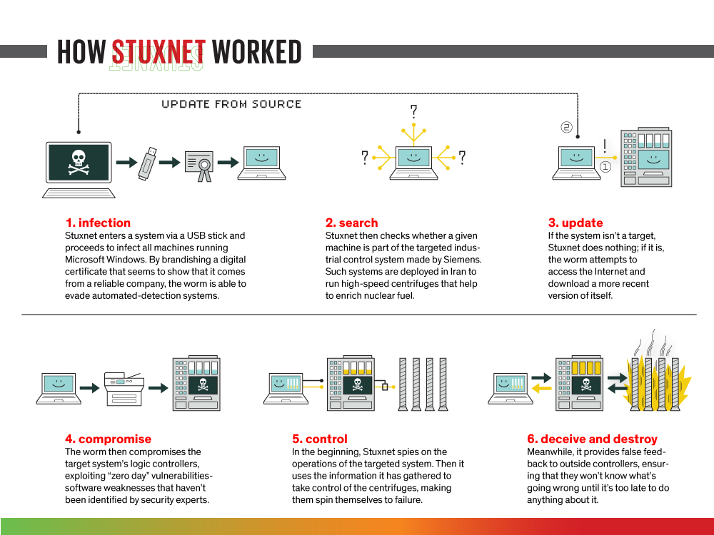
NJ CYBERSECURITY & COMMUNICATIONS INTEGRATION CELL. (2017, August 10). Stuxnet. Retrieved from NJCCIC: https://www.cyber.nj.gov/threat-profiles/ics-malware-variants/stuxnet

Slide 9
Pertinent questions
Who wrote Stuxnet?
How did the authors get the private keys of two corporations?
Are the authors still out there? If so, what are they doing now?

